Slide 1

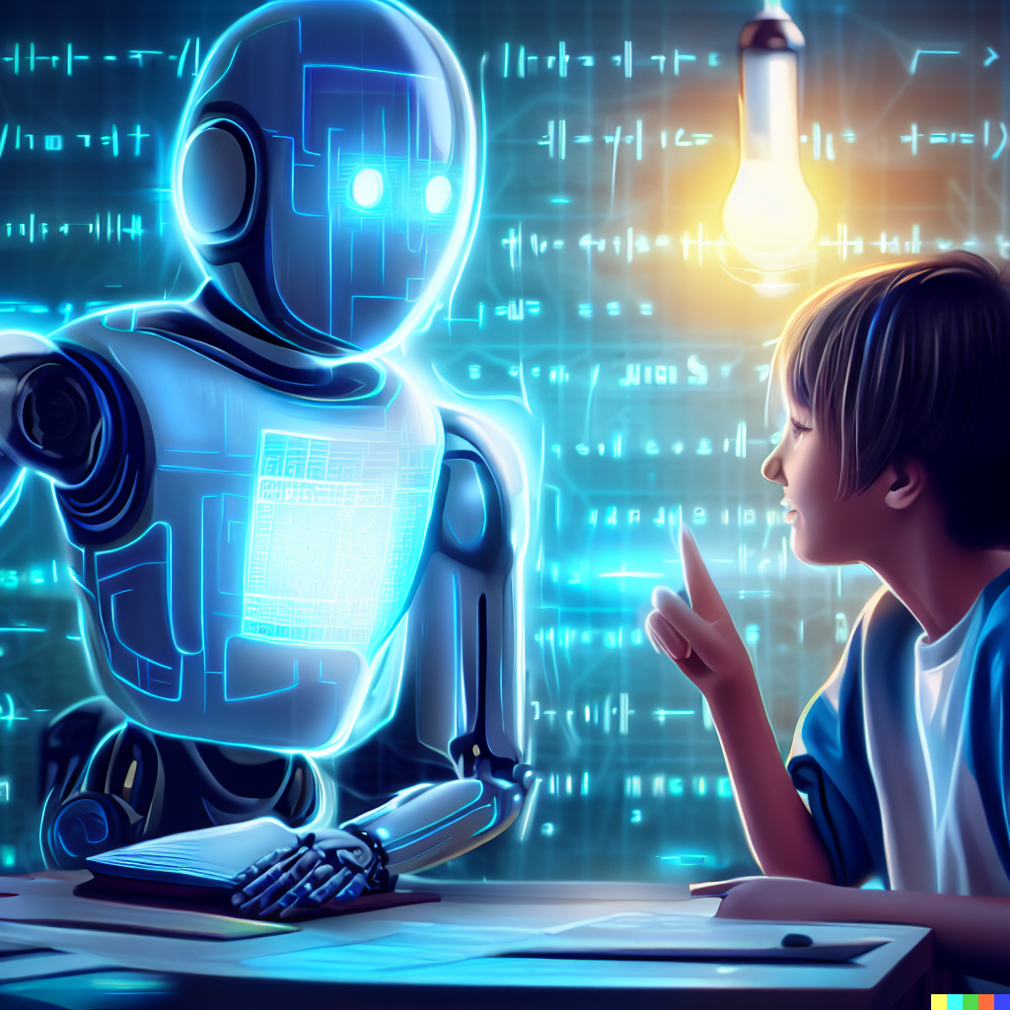
AI TUTOR WITH CHAT FUNCTIONALITY
Intelligent Educational Assistant using Open-Source AI
Department :- B.TECH cse ai & ml
By:
Satyam gupta (2822319)
Aryan rana (2822339)

Slide 2
Introduction
An intelligent educational assistant designed to provide personalized learning support through conversational artificial intelligence. Our system leverages open – source language models to deliver instant, contextually relevant educational responses across multiple subjects and skill levels.
Key Features:
Real-time educational query answering
Personalized learning paths
Progress tracking and analytics
Zero operational cost solution

Slide 3
Problem Statement and Our Approach
There are many problems such as :
47% of Indian students lack quality personalized tutoring
Traditional tutoring costs ₹ 40,000+ annually
Limited 24/7 educational support availability
Our Solution :
Zero-cost AI tutor using open-source models (BERT/GPT-2)
Instant response system with 85% accuracy
Web –based platform accessible on any device
Multilingual support
Approach: Replace expensive commercial APIs with free, open-source AI technologies while maintaining educational quality.

Slide 4
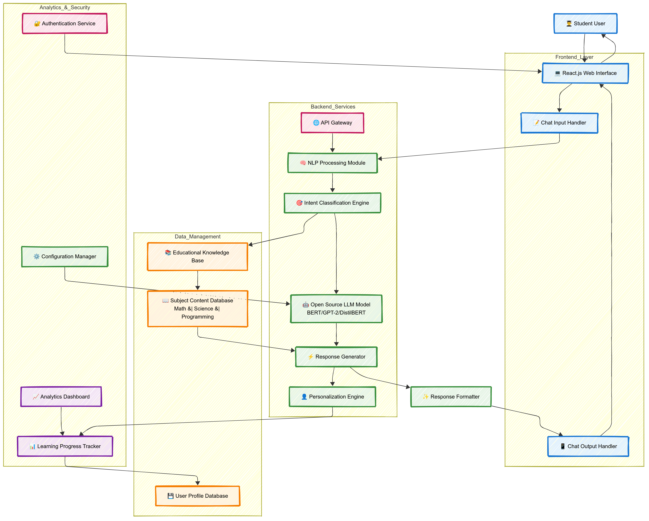

Slide 5
Workflow
Week | Task | Deliverable
1 | Setup development environment, initialize repository | Tech stack + GitHub repo
2 | Implement NLP preprocessing pipeline | Text processing module
3 | Integrate Hugging Face transformers, train intent classifier | AI model integration
4 | Build educational knowledge base, collect training data | Content database
5 | Develop React.js frontend with chat interface | Interactive UI
6 | Implement response generation and personalization | Complex AI pipeline
7 | Add progress tracking, analytics dashboard | Feature – complete app
8 | Testing, optimization, documentation | Production – ready MVP

Slide 6
Progress Status
AI Tutor - Backend Completed ✅
Flask API Server: Running on port 5000
BERT Model: Loaded with 99.9% accuracy
Database: SQLite operational with conversation history
Knowledge Base: 7+ educational topics loaded
Real-time Chat: API endpoints active and responding

Slide 7
Strengths
Personalized Training: AI tutors can adapt content, pace and difficulty level based on the learner’s progress and style.
24/7 availability: Learners can access support anytime, anywhere – unlike human tutors with limited schedules.
Scalability: AI tutors can teach and support thousands of leaners simultaneously, making education more affordable and accessible.
Instant Feedback: Learners get immediate responses on quizzes, assignments, or practice, which speeds up the learning process.
Consistency in Teaching: Unlike human tutors who may vary in quality, AI delivers uniform and structured content.
Cost-Effective: Over time, AI tutors reduce the need for multiple instructors, lowering training or educational costs.

Slide 8
Challenges
Limited GPU Resources
Sol: Google Colab Pro + model distillation
Indian Context Data
Sol: Web scraping NCERT + manual labelling + data augmentation
Intent classification
Sol: Refined taxonomy from 20 to 15 clearly categorized
Response Time vs Accuracy
Sol: Using distilled models + quantization + caching

